Slide 1
Machine Learning Hackathon CG 2022
Team Name - n00b
Team Leader Name - Anand mohan kumar
Team Leader Email Address- kanandmohan8@gmail.com

Slide 2
Brief description of the problem at hand:
Create a Machine learning model based on the data to identify a website is legitimate or phishing website

Slide 3
Data Description
Data set consist of 30 features of a phishing website.
The values of attributes are ( -1 , 0 , 1) except for key feature which is incremental.
1 represents the legitimate
0 represents suspicious
-1 represents phishing

Slide 4
Technology/Tool Stack Used:
Language used - Python
IDE - google colab
Library used -
Numpy ,
pandas ,
matplotlib ,
pymrmr ,
xgboost ,
yellowbrick

Slide 5
Feature Selection and Pre Processing
Top 5 , 10 and 15 features where selected using mRMR (minimum Redundancy Maximum Relevance)
80 % of Data was used for Training and 20 % for testing

Slide 6
Selected Features
Top 5 features :
['having_Sub_Domain', 'port', 'HTTPS_token', 'web_traffic', 'URL_Length']
Top 10 features :
['having_Sub_Domain','port','HTTPS_token','web_traffic','URL_Length','Google_Index', 'Links_in_tags','Page_Rank','Links_pointing_to_page','age_of_domain']
Top 15 features :
['having_Sub_Domain','port', 'HTTPS_token', 'web_traffic', 'URL_Length', 'Google_Index', 'Links_in_tags', 'Page_Rank', 'Links_pointing_to_page', 'age_of_domain', 'Prefix_Suffix', 'Domain_registeration_length', 'Statistical_report', 'SFH','having_At_Symbol']

Slide 7
Algorithms used
Logistic Regression
Decision Tree
KNN
SVM
Random forest
XGboost

Slide 8
Score of each algorithm
 | Top 5 feature | Top 10 feature | Top 15 feature
Logistic Regression | 69.38% | 74.86% | 78.23%
Decision Tree | 76.55% | 77.61% | 82.69%
KNN | 75.89% | 82.52% | 87.49%
SVM | 76.99% | 81.20% | 86.89%
Random forest | 76.75% | 77.84% | 85.78%

Slide 9
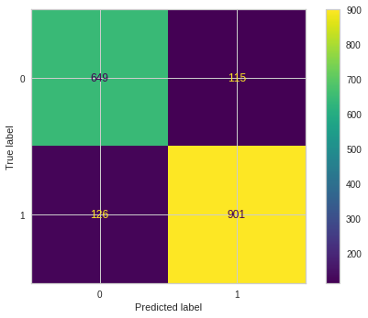
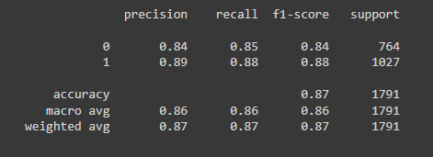
Best model
Finally KNN was selected with top 15 features

Slide 10
Thank you

